Slide 1
Promoting Success of Diverse Students in Gateway Engineering Courses Using Step-based Tutoring
Workshop Presenters: Prof. Brian J. Skromme
School of Electrical, Computer, and Energy Engineering
Arizona State University, Tempe, AZ 85287-5706; skromme@asu.edu
Dr. Wendy Barnard (Independent Evaluator)
College Research and Evaluation Services Team
Arizona State University, Tempe, AZ 85287-2111
Work supported by the National Science Foundation through the
Improving Undergraduate STEM Education Program under Grant No. 1821628.

Slide 2
Introduction
Broadening participation and expanding diversity is a key goal in engineering education
Non-traditional learners are an important constituency; need online access as alternative to traditional on-campus instruction
Example: ASU’s fully online Bachelor in Electrical Engineering degree; enrollment now exceeds that of on-campus students
Remote instruction is also popular with on-campus students
New technologies and approaches are needed to facilitate online instruction and to support diverse student populations
Step-based computer-aided tutoring is one such promising technology, and is currently implemented as the Circuit Tutor program developed at ASU

Slide 3
Step-Based Tutoring
Step-based tutoring differs from answer-based tutoring in that it accepts & analyzes every step of a student’s work, instead of just the final answer
Examples of (usually) answer-based tutors are commercial and other HW systems such as WileyPLUS, Pearson’s Mastering, McGraw-Hill Connect, WeBWorK, etc.
Meta-analyses have shown that step-based systems generally outperform answer-based ones in student learning gains:
  VanLehn found 0.76σ improvements for step-based tutoring, and 0.40σ for substep-based tutoring vs. 0.79σ for expert human-based tutoring compared to a prior result of 0.31σ for answer-based tutors (Educat. Psychologist, vol. 46, pp. 197-221, 2011).
  Kulik & Fletcher found 0.60 effect size for step-based intelligent tutoring systems (ITS) and 0.63 for substep-based ITS (Rev. Educat. Res. vol. 86, pp. 42–78, 2016). They argued the difference in substep-based results from VanLehn is due to his inclusion of studies with unconventional control groups.
Note that Circuit Tutor is not a conventional ITS, though it is step-based, embodies a lot of intelligence about circuits, and has achieved larger learning gains in many cases than such systems have

Slide 4
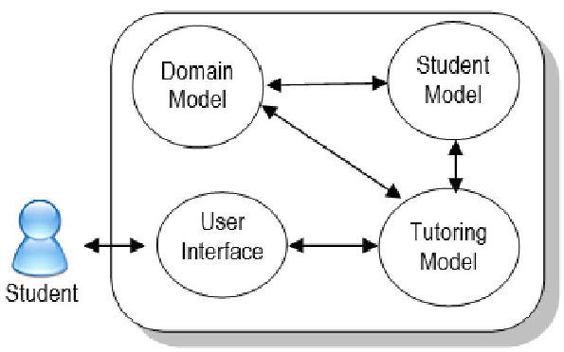
Traditional ITS Architecture
After Thai-Nghe & Schmidt-Thieme, Proc. 7th Internat. Conf. Knowledge & Systems Engrg, 2015, pp. 61-66

Slide 5
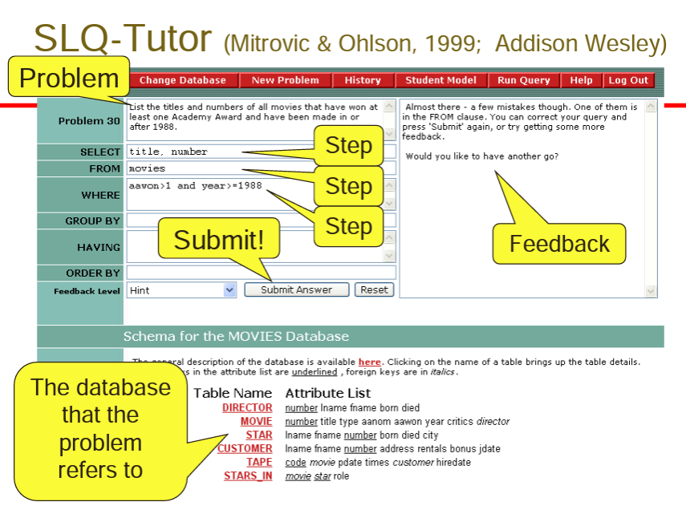
SQL-Tutor (Mitrovic & Ohlson, 1999; Addison Wesley)
After K. VanLehn, https://www.cs.washington.edu/mssi/2012/KVL_SociallyITS.pdf

Slide 6
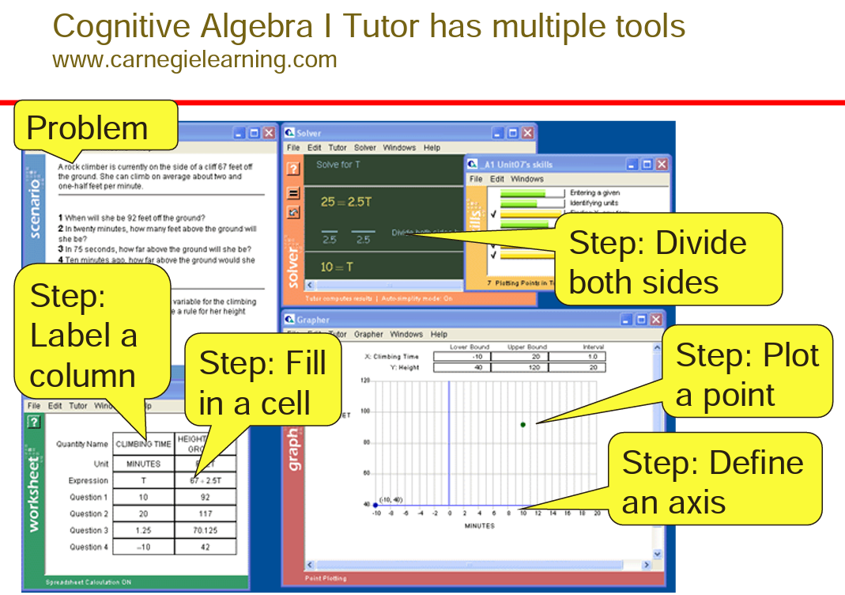
After K. VanLehn, https://www.cs.washington.edu/mssi/2012/KVL_SociallyITS.pdf

Slide 7
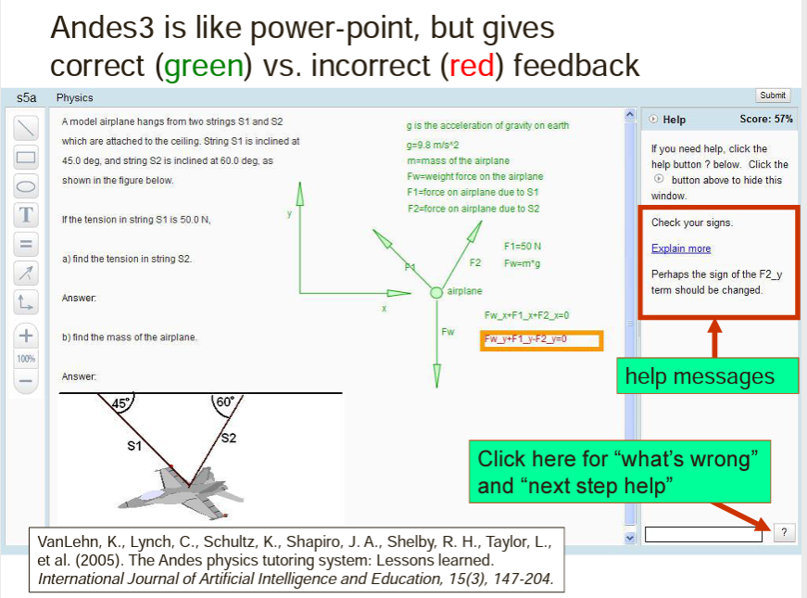
After K. VanLehn, https://www.cs.washington.edu/mssi/2012/KVL_SociallyITS.pdf

Slide 8
Discussion
  What sorts of problems do you assign that require complex procedures to arrive at a final answer that can be checked (e.g., against an answer in the back of the book)?
  What sort of feedback could be provided “along the way” if you had greater visibility into students’ processes WHILE they are doing it?
  Could a computer/ITS plausibly be configured to do that?
  What sorts of pedagogical features or reinforcements could be provided to help & motivate students?

Slide 9
Overview of Circuit Tutor
Detailed information is available at www.circuittutor.com
Circuit Tutor is a step-based tutoring system for linear circuit analysis that accepts numerous types of inputs such as equations, matrices & simplified equations, numerical values, waveform sketches, and an on-screen interactive circuit editor
The system also randomly creates its own problems, varying both circuit topology and element values, providing an unlimited supply of fully worked & explained examples and corresponding problems at graded levels of difficulty
Students are never penalized for wrong answers but must just work a new problem of the same type for full credit, encouraging mastery learning
Special pedagogical devices such as color-coded node voltages and mesh currents are used to help promote understanding of parallel & series relationships
Interactive, multiple-choice tutorials (similar to textbook material) are available on each relevant topic prior to viewing worked examples and doing exercises

Slide 10
Overview of Circuit Tutor (cont.)
Other features include 83 videos of every level and problem type in every game being worked in the system to illustrate the user interfaces, the technical aspects of problem solving, including fully detailed algebra where applicable and demonstrations of calculator usage (TI models), e.g., for complex number calculations: https://www.youtube.com/channel/UCnn_0DTFVFpiorlWiTTUVvg/videos
  Includes a general introduction to the Circuit Tutor system and topics such as Gaussian elimination
  Accessible via direct links to the relevant videos & channels inside the exercises (very popular; ~56,000 views to date)
Another feature is automatic generation of PDF transcripts of student work, including both correct and incorrect steps (labeled as such); overcomes a major disadvantage of traditional electronic HW systems where students have no record of their work and nothing to review for exams
  Transcripts are stored on the student’s computer and can be accessed at any time (from within Circuit Tutor, or independently)
We also give heavy emphasis to conceptual issues, such as recognizing elements in series & parallel

Slide 11
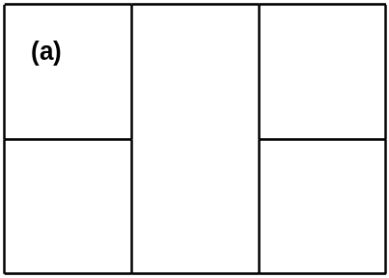
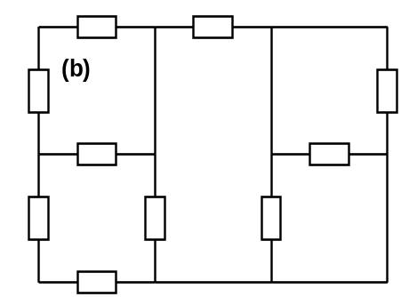
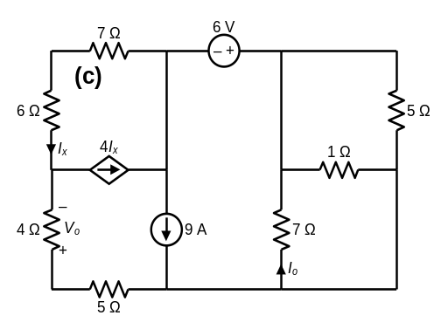
Random Circuit Generation Approach
Three-step Process for Circuit Generation
Circuits randomly generated on square grids to avoid graphical interferences (can represent any planar circuit)
A multi-step approach is used to create new circuits:
  Step (a): Generate a “topology” consisting only of opens and shorts; must have correct number of meshes, be connected and not hinged
  Step (b): Replace some of the shorts by generic circuits elements, placing at least two/mesh (including outer mesh) to avoid shorted elements; check that result is not hinged
  Step (c): Find all or many trees of this network, and place required number of voltage sources and inductors on the twigs, and required # of current sources & capacitors on the links (resistors can be placed anywhere). Then choose random element values and pick control variables for dependent sources (following additional rules for latter)
  Step (d): Choose “sought variable(s)” students are to find (currents, voltages, powers), following certain rules

Slide 12
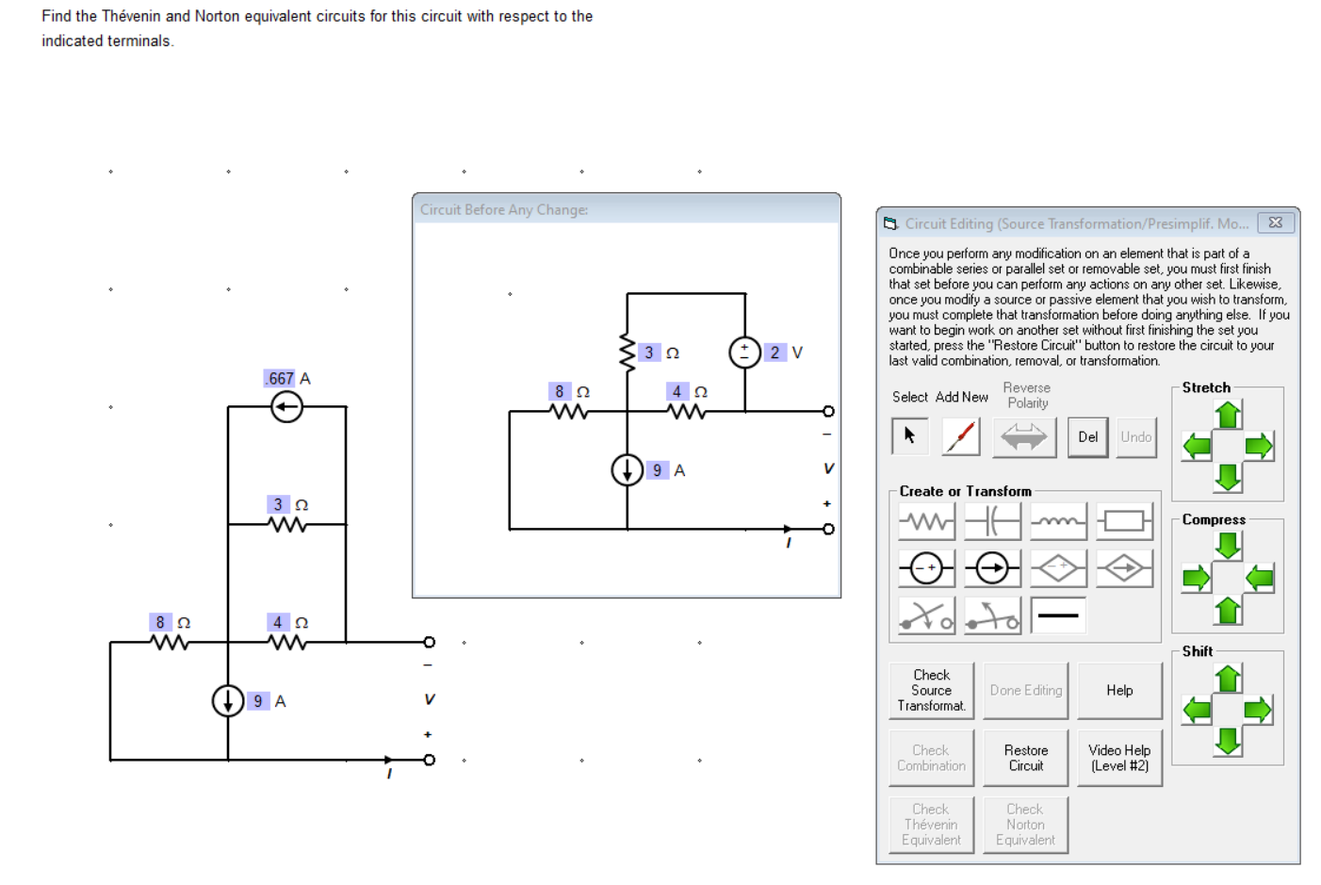
Examples of Step-Based User Interfaces: Interactive Circuit Editor
Supports shifting, splitting, or compressing a circuit to make room for operations such as source transformations (illustrated at right)
Automatically shows the last valid circuit for reference
Automatically checks a wide variety of editing operations in different restricted editing modes, such as source killing in superposition, series and parallel combinations of sources and passive elements (both DC and AC), dragging elements to new positions, changing element types, and adding new ones, and drawing Thévenin & Norton equivalents connected to a supplied set of terminals

Slide 13
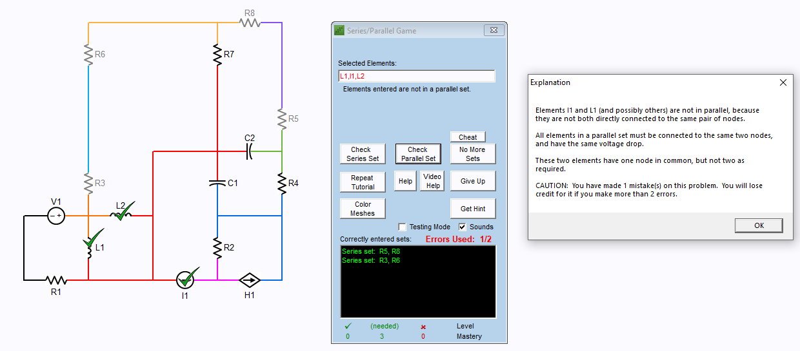
Examples of Step-Based User Interfaces: Selection Interface

Slide 14
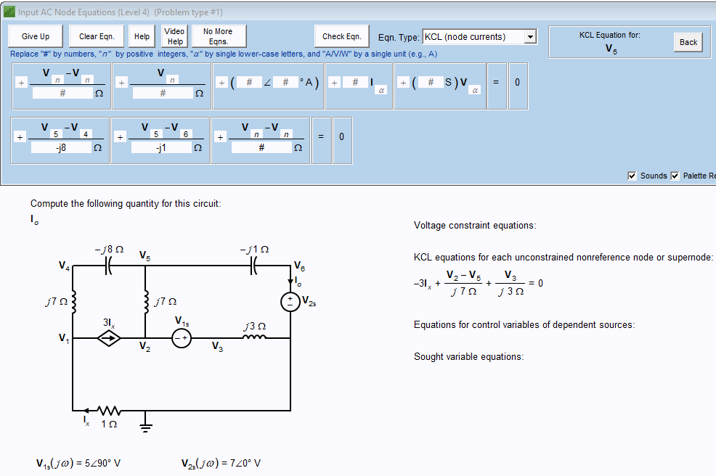
Examples of User Interfaces: Template-Based Equation Entry System

Slide 15
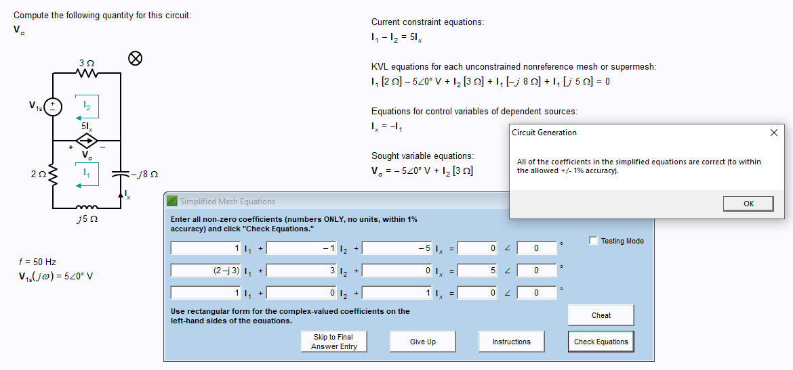
Examples of User Interfaces: Simplified Equation Entry

Slide 16
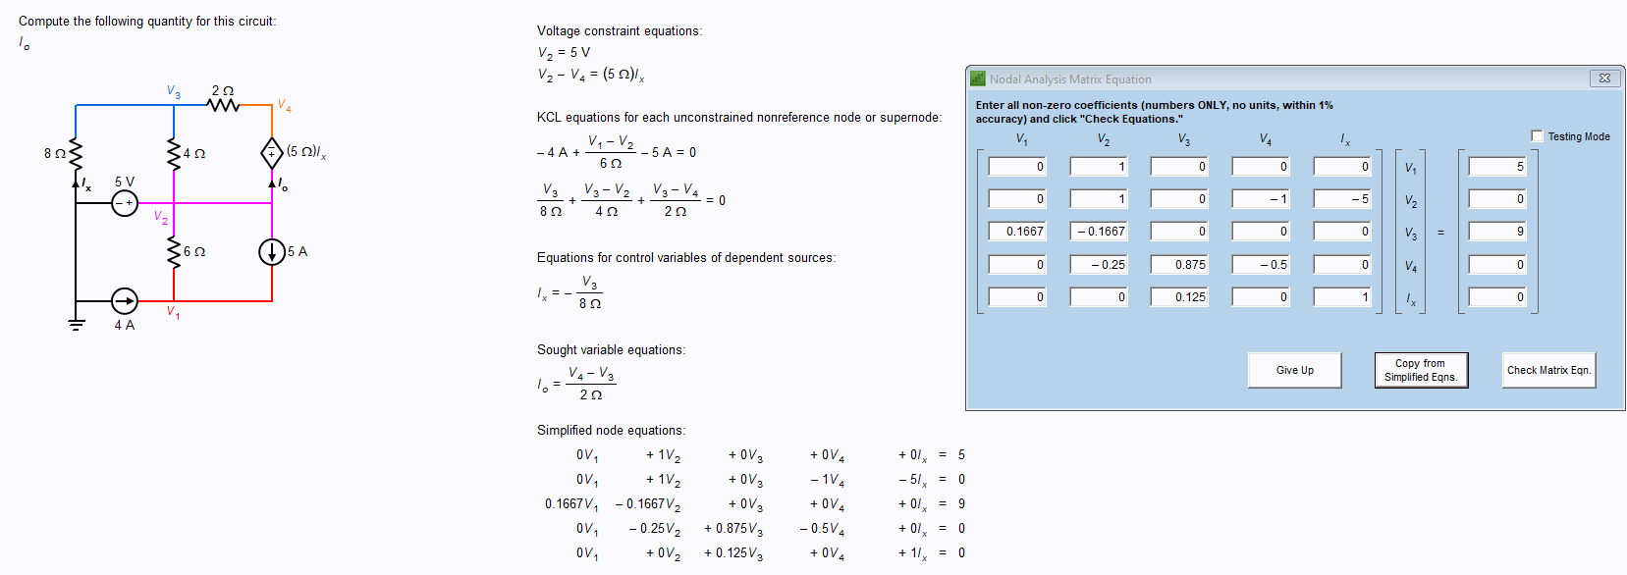
Examples of User Interfaces: Matrix Equation Entry

Slide 17
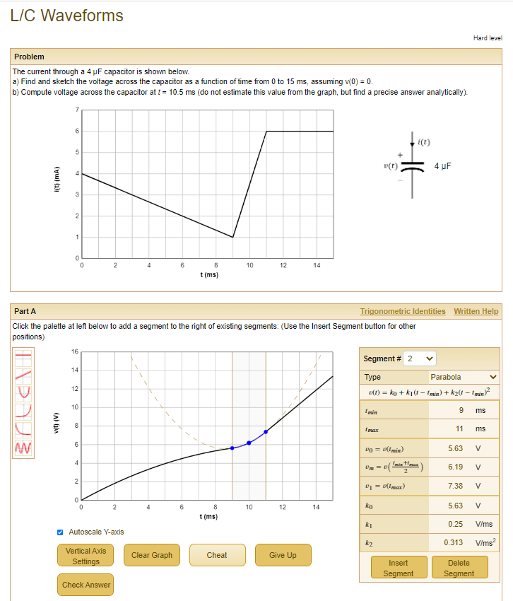
Examples of User Interfaces: Waveform Sketching

Slide 18
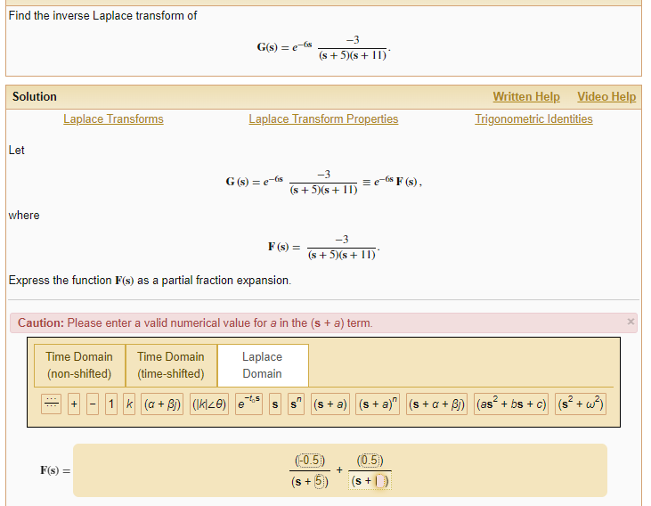
Examples of User Interfaces: Web-based Algebraic Entry System
(Used, e.g., in Bode plots or Laplace transforms games)

Slide 19
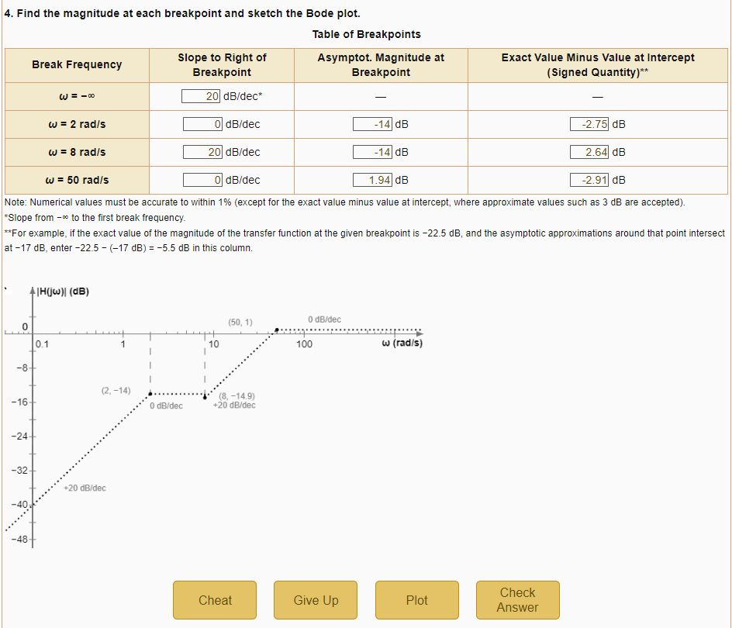
Examples of User Interfaces: Web-based Table to Specify Bode Plots

Slide 20
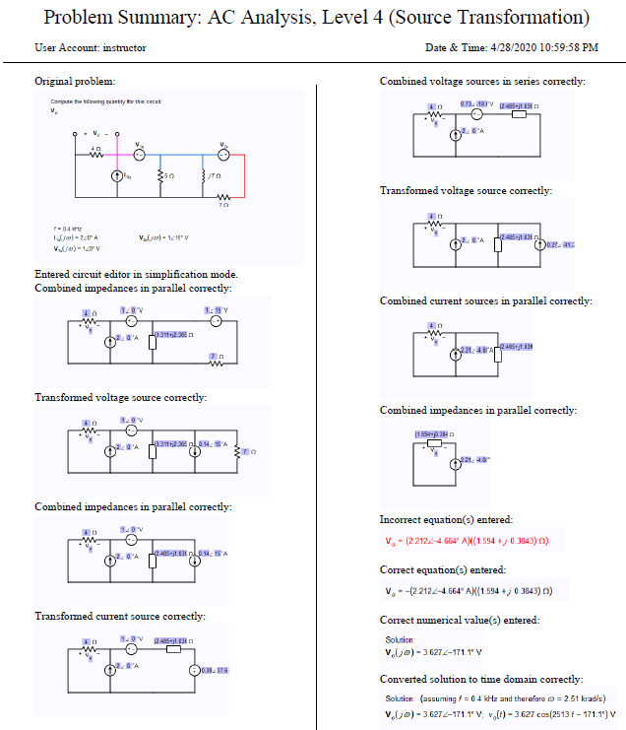
Sample Transcript of Student Work

Slide 21
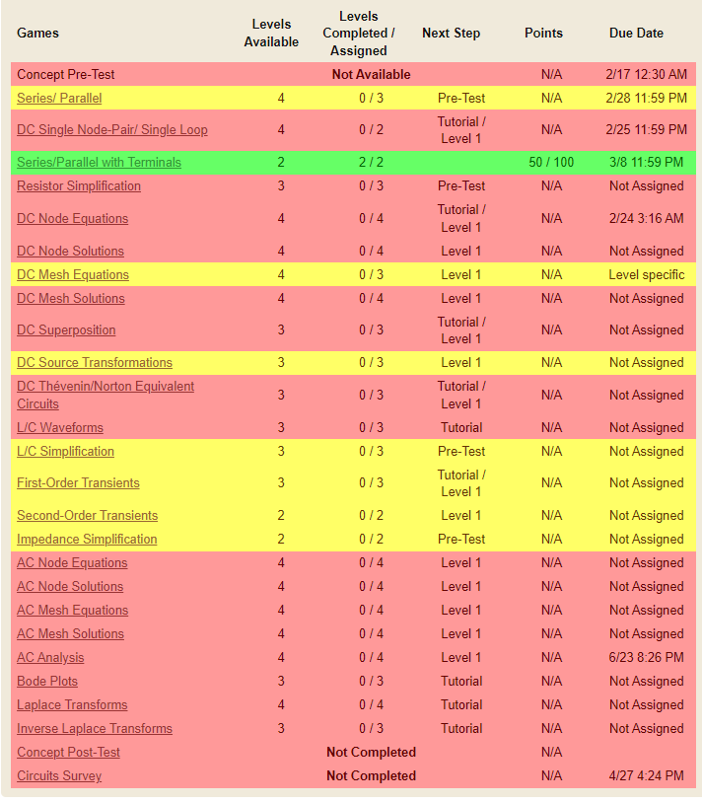
Menu of Released Games (23 total)
Covers most major topics in linear circuit analysis
Currently developing game for Laplace transform-based circuit analysis, and de-bugging two waveform sketching games
Will develop module for operational amplifiers, others as time permits

Slide 22
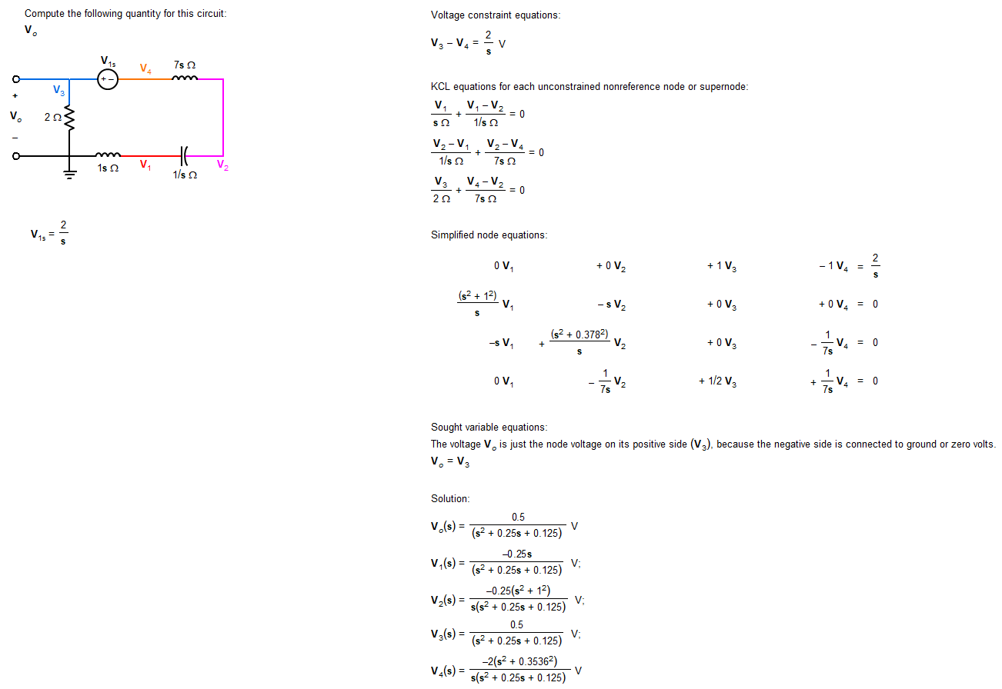
Laplace-Transform-Based Circuit Analysis (Under Development)

Slide 23
Summary of Seven Controlled Experiments Using Circuit Tutor (10 modules)
Date | Location | Lab/Classroom-Based | Module(s) Evaluated | Control Condition | Random Assignment? | Pre-Test Description | Post-Test Description | Blind Grading? | N | p | Effect Size (Cohen d-value) | Student Survey Results
12/2012 | ASU | Lab (Paid student volunteers in circuits course within last year) | Series/Parallel 1.0, DC Node Equations | Worked similar textbook problems on paper (no feedback) | Yes | 25 min. Paper Test | Same (two forms used randomly) | Yes | 33 | <0.05* | 1.21 | d = 0.91 (p < 0.05) on Instructional Materials Motivation Survey
Fall 2014 | ASU | Classroom-based (one section) | DC Node Equations, DC Node Solutions, DC Mesh Equations, DC Mesh Solutions | Worked similar problems in WileyPLUS | Yes (ea. student used Circuit Tutor modules on 1 topic, WileyPLUS on the other) | None | Compared scores on the HW Assignment | Yes | 73 | 0.0084* | 0.41 | None (but 33% of students then did voluntary work in CT, none did so in WileyPLUS)
Fall 2014 | Univ. Notre Dame | Classroom-based (two sections) | Series/Parallel 1.0, Series/Parallel with Terminals | Read textbook discussion, did paper problems | No; different sections assigned to different conditions | Paper Test | Same (two forms used randomly) | Yes | 32 total | <0.001* (1-way AOV with pre-test as co-variate) | 0.97 | None
Fall 2015 | ASU | Classroom-based (one section) | DC Node Equations, DC Node Solutions, DC Mesh Equations, DC Mesh Solutions | Worked similar problems in WileyPLUS | Yes (ea. student used Circuit Tutor modules on 1 topic, WileyPLUS on the other) | None | Paper Quiz (45 min.) | Yes | 70 | Node anal.: <0.05* Mesh anal.: 0.38 | Node anal.: 0.72 Mesh anal.: [0.21] (not signif.) | 86% preferred CT, 9% preferred WP
Spring 2019 | ASU | Classroom-based (one section) | DC Superposition, DC Source Transformations | Worked similar problems in WileyPLUS | Yes (ea. student used Circuit Tutor modules on 1 topic, WileyPLUS on the other) | None | Limited; one 12-pt. problem on each topic on 100-pt. exam | Yes | 62 | DC Superpos: 0.56 DC Src Trnsfrm.: 0.92 | DC Superpos: [ 0.026] DC Src Trnsfrm.: [-0.15] (neither signif.) | DC Superpos: 84% preferred CT, 11% preferred WP DC Src. Transfrm: 68% preferred CT, 23% preferred WP
Fall 2019 | ASU | Classroom-based (Section 1) | DC Superposition, DC Source Transformations, DC Thevenin/Norton, AC Analysis (same 3 topics) | Worked similar textbook problems on paper (no feedback) | Yes (ea. Student used CT modules for DC or AC topics, randomly assigned) | None | DC Topics: 100 pt. quiz, 2 questions on exam (38 pts); AC Topics: 1 question (22 pts.) on exam | Yes | 53 | DC Quiz: 0.53 DC Exam†: 0.94 AC Exam‡: 0.55 | DC Quiz: [-0.13] DC Exam: [0.033] AC Exam: [-0.26] (none signif.) | (Sections merged for survey) Paper HW users would prefer different HW system more than CT users (p = 0.000, d = 2.07); CT helped learn better than paper (p = 0.000, d = 1.11)
Fall 2019 | ASU | Classroom-based (Section 2) | (Same as above) | (Same as above) | (Same as above) | None | (Same as above) | Yes | 59 | DC Quiz: 0.046* DC Exam†: 0.014* AC Exam‡: 0.64 | DC Quiz: 0.54 DC Exam: 0.64 AC Exam: [-0.13] (not signif.)
†Some cross-contamination, probably reduced effect size
‡Heavy cross-contam. from prior expt.; prob. invalid
*Statistically significant result

Slide 24
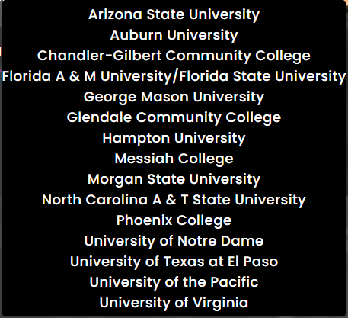
Overall (Cumulative) Usage of Circuit Tutor
To date, system has been used by over 9000 students (active users) in 249 distinct class sections taught by 67 distinct instructors at 16 different colleges & universities in the United States & Canada
User institutions include large and medium-sized state-supported universities, an elite private institution, smaller private institutions, community colleges, and five different minority-serving institutions
A total of 621 student users in asynchronous online courses (all at ASU) are included above (from Fall ’14-present)
At least 896 users who attended class synchronously at ASU via Zoom during the COVID-19 pandemic are included above, along with 366 others who presumably also used some form of remote instruction from Spring 2020 through Spring 2021

Slide 25
Sample Student Comments (Comparing Circuit Tutor to WileyPLUS)
Simple, Circuit Tutor actually gives you examples and shows you want to do before making you do it. WileyPLUS does not. Circuit tutor walks you through problems clearly and one step at a time. It also allows you infinite attempts so you can attempt the problem repeatedly with less stress about losing points. Circuit tutor's explanations for problems are also easier to follow. I liked Circuit Tutor more because I could do a ton of problems. I liked that even if I couldn't figure it out, I could ‘give up’ and it would thoroughly explain how to do everything so I could understand what I did wrong and then do a new problem and try to get that right. I seem to retain more of the content when I am doing this one. I have trouble with WileyPLUS because, if I have trouble with a problem, the hints do not explain what I am doing wrong. It's really frustrating because I could be 2 or 3 wrong attempts in and I do not know what I'm doing wrong. I preferred Circuit Tutor because it was more forgiving in the aspect of not just showing that your answer was wrong like WileyPLUS, it helped guide you to the solution. I felt it was a more effective learning tool, while WileyPLUS would be better as a quiz tool after using Circuit Tutor. When it came to the quiz I felt much more confident on the node questions vs the mesh questions because of Circuit Tutor. I plan to use Circuit Tutor some more to prepare for the upcoming test. Circuit Tutor is far better. WileyPLUS is not only more difficult, but only allows 4 attempts. WileyPLUS discourages me while Circuit Tutor teaches me.

Slide 26
Supporting Students During the COVID-19 Pandemic
At the end of the Spring 2020 semester, where students transitioned from in-class instruction to remote learning, they were asked if the COVID-19 pandemic changed their experiences with Circuit Tutor
Most students who answered this question (73%; N = 43) reported no changes in their experiences with Circuit Tutor since the shift to an online learning environment
Those students who reported their experiences changing due to the pandemic (27%; N = 16) all stated positive ways in which their experiences were impacted
Many stated that Circuit Tutor was utilized at a higher frequency and, overall, was more helpful to them during the conversion to an exclusively virtual learning environment due to COVID-19, particularly for homework assessments

Slide 27
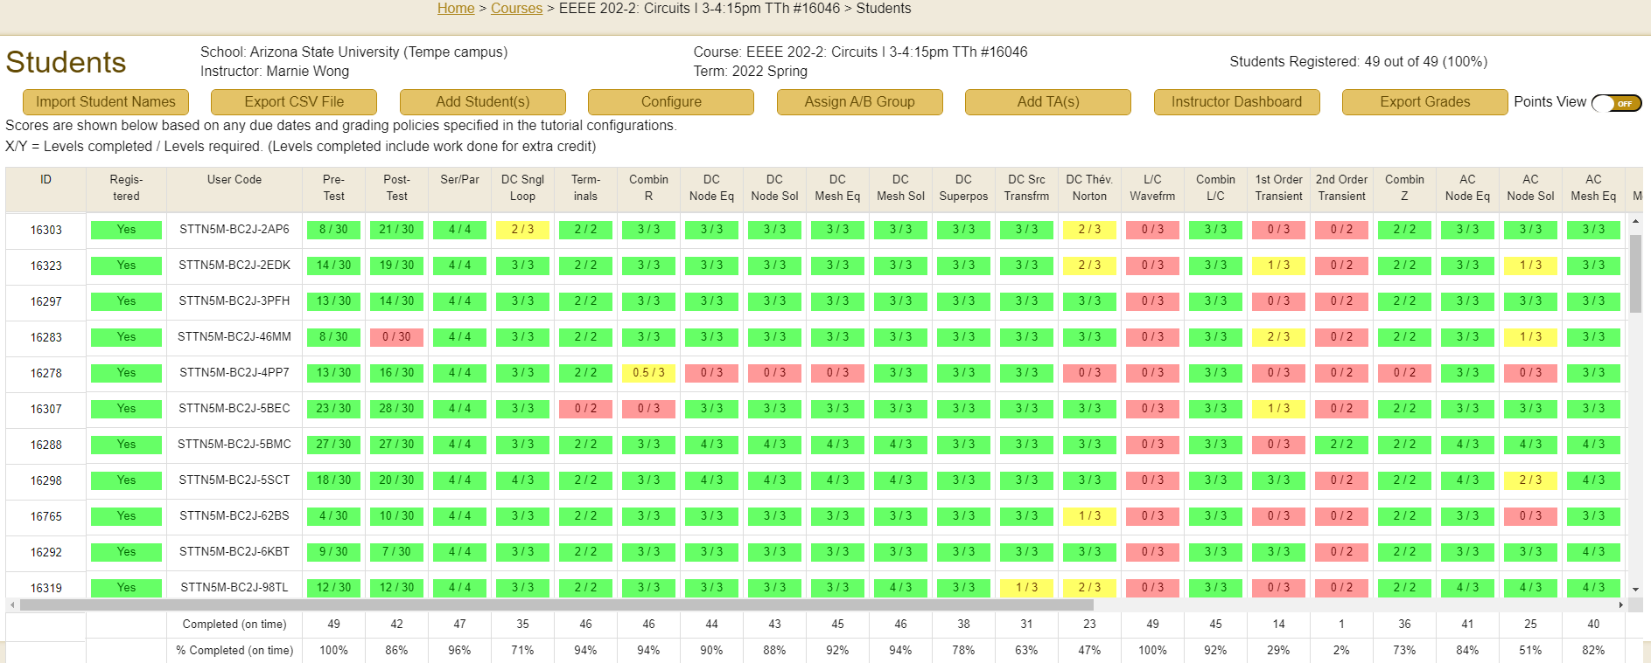
Administrative Features
Gradebook shows student progress & allows easy export into LMS gradebooks; can show student names, etc.
Can automatically distribute registration codes to students, add TA’s, set assignment options, etc.

Slide 28
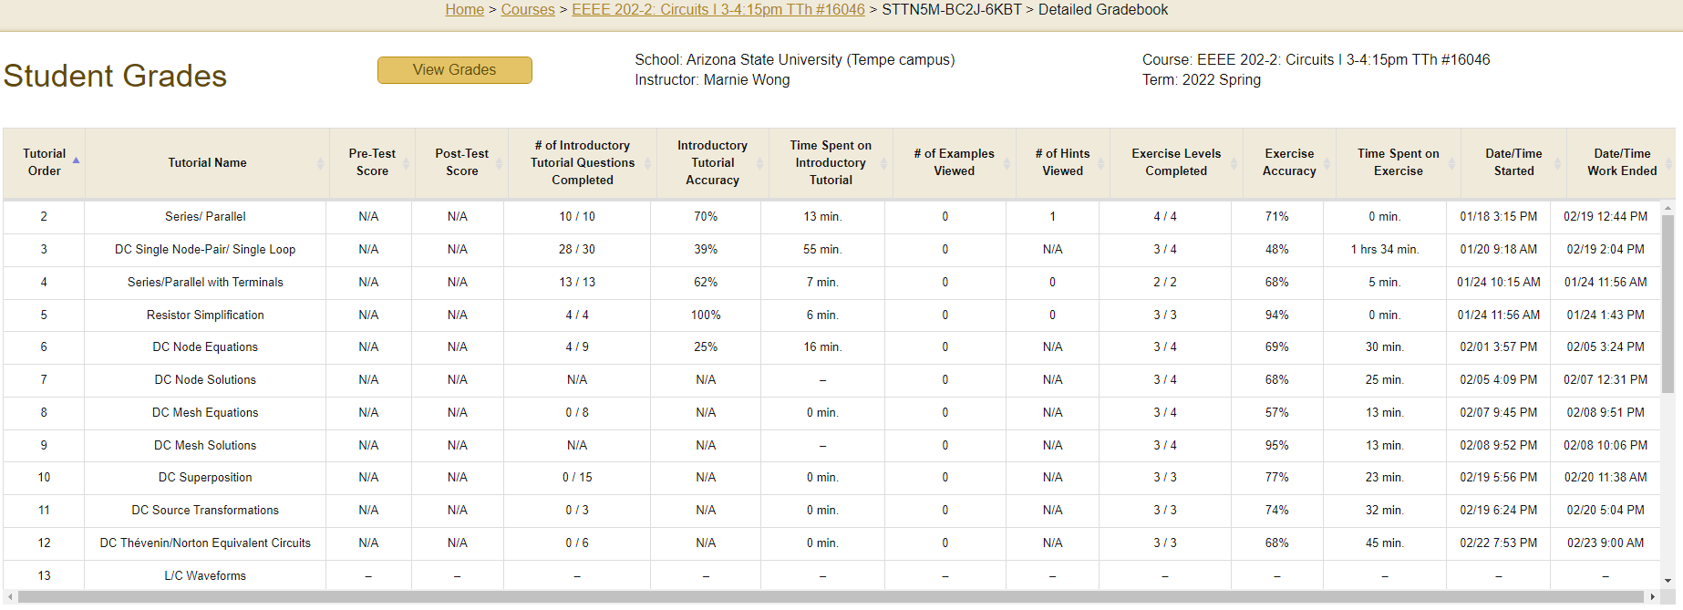
Administrative Features (cont.)
Detailed view in gradebook available for each student, showing accuracy, time on task, etc.

Slide 29
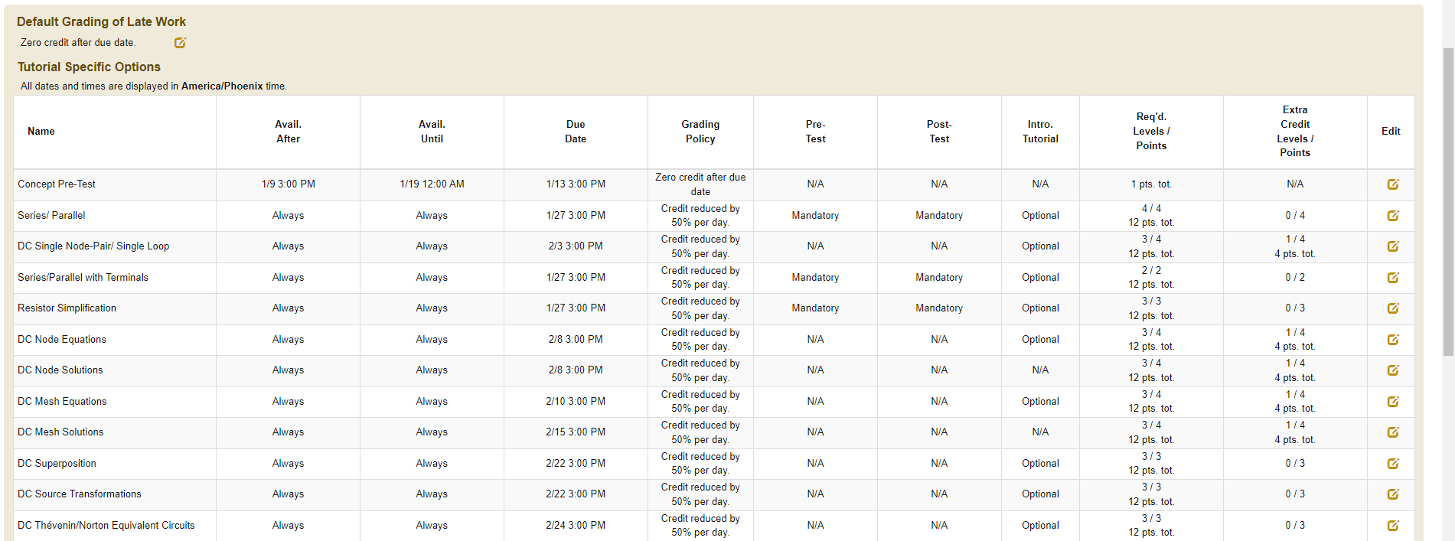
Administrative Features (cont.)
Instructor has configuration menu to set up due dates, availability, required items & levels, point values and extra credit, etc. for each course section; can import prior settings while shifting dates

Slide 30
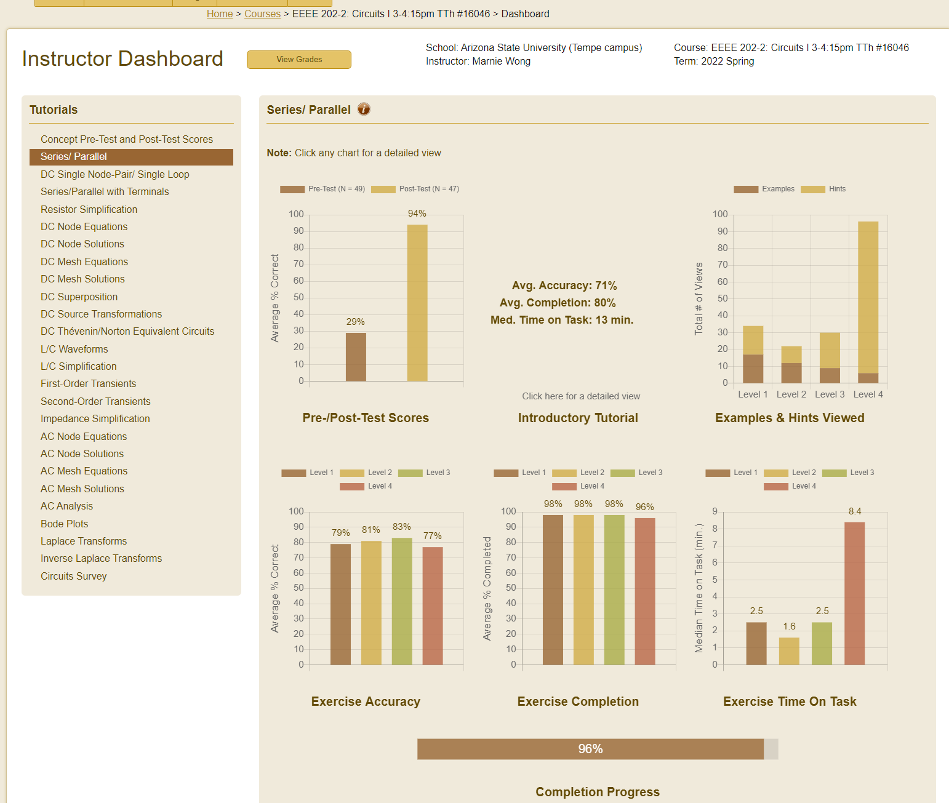
Administrative Features
(cont.)
Instructor dashboard allows instructor to view overall student progress, accuracy, time on task, pre- & post-test scores, etc. for each game and each class section
Detailed views also available for each chart

Slide 31
New Project Discoveries (!) about Linear Circuit Analysis
New approaches to teach conceptual aspects of electricity
  Use of microscopic Drude model, balls in tube model; comparing & contrasting voltage & current sources, control model for sources; linear load-line models for voltage & current division, etc.
  Use of these approaches in class by the P.I. led to higher pre-test adjusted post-test performance on the DIRECT concept inventory than in sections taught by 10 other instructors not using those approaches
  (p < 0.001) [B. J. Skromme & D. H. Robinson, in Amer. Soc. Engrg. Educat. Annu. Conf. & Expo., Seattle, WA, 2015,
  pp. 14125-1–14125-15.]
Novel approaches to circuit simplification
  Traditional methods include series & parallel simplification of passive elements and independent sources, wye-delta transformations, source transformations, and some others (less used)
  Circuit Tutor emphasizes removal of irrelevant hinged portions of circuits (where circuit can be drawn with only one wire or node connecting two or more portions of a circuit, effectively isolating them (special cases are shorted or “dangling” circuit elements) (concept was previously known)
  Developed additional novel concepts of voltage-splittable and current-splittable circuits, where “chains” of voltage or current sources also isolate different portions of a circuit (generalizes idea of “redundant” circuit elements); implemented concept in Circuit Tutor

Slide 32
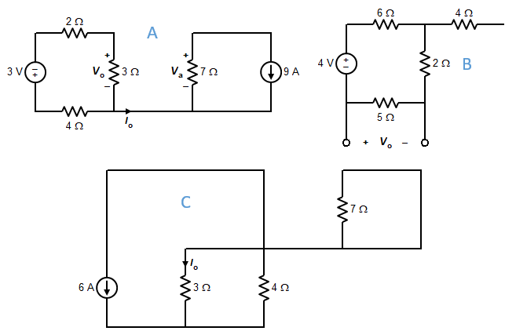
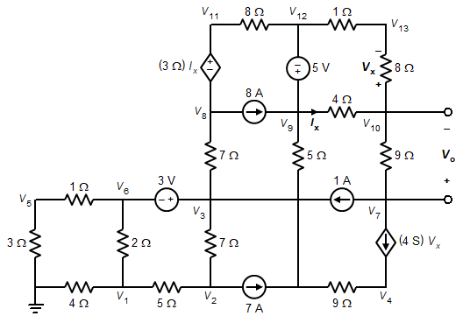
Examples of Hinged Circuits
Removal of a single node leaves circuit disconnected
Situation often happens in steady-state versions of switched transient circuits, and when doing superposition; but rarely discussed in elementary textbooks!

Slide 33
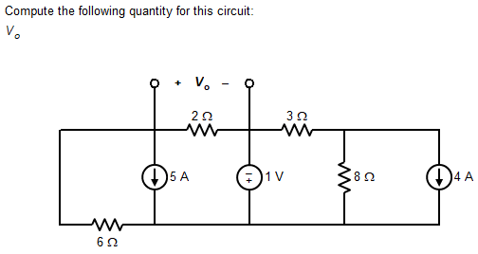
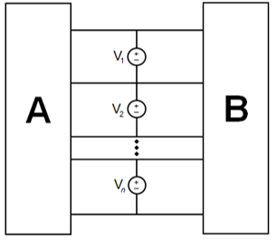
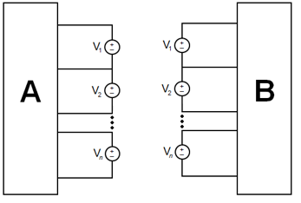
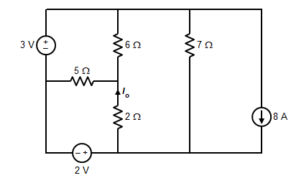
Voltage-Splittable Circuits (New Concept)
Changing a chain of voltage sources to shorts leaves circuit hinged; or changing them to shorts and removing the resulting short leaves circuit disconnected
Situation happens in steady-state versions of switched transient circuits, and when doing superposition; never discussed in elementary textbooks! (except rarely for “redundant” elements in parallel with a single voltage source)
See B. J. Skromme & D. H. Robinson, in Amer. Soc. Engrg. Educat.
Annu. Conf. & Expo., Seattle, WA, 2015, pp. 14125-1–14125-15.
Examples:

Slide 34
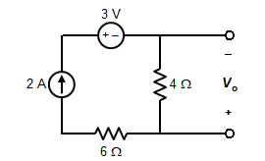
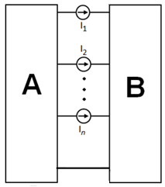
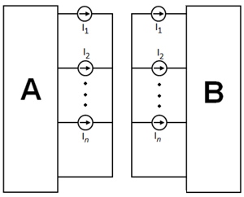
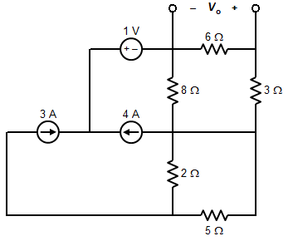
Current-Splittable Circuits (New Concept; Dual of Voltage-Splittable Case)
Changing a chain of current sources to opens leaves circuit hinged; or open-circuiting them and removing a wire leaves circuit disconnected
Situation happens in steady-state versions of switched transient circuits, and when doing superposition; never discussed in elementary textbooks! (except rarely for “redundant” elements in series with a single current source)
Examples:

Slide 35
Modifying the Definition of a Mesh (Basic Unit Used in Mesh Analysis)
            Nearly universal modern textbook definition:
            A mesh is a loop in a planar circuit that does not enclose any smaller loop
            (A loop is a closed path passing through at least one circuit element)
            This definition excludes the periphery of a circuit (often termed the “outer mesh”) as a mesh!
            Inconsistent with fact that projecting a planar circuit onto the surface of a sphere makes outer mesh equivalent to inner meshes
            Identity of meshes should not depend on way circuit is drawn, only on how it is connected!

Slide 36
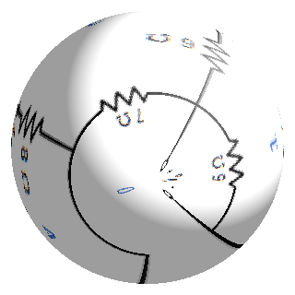
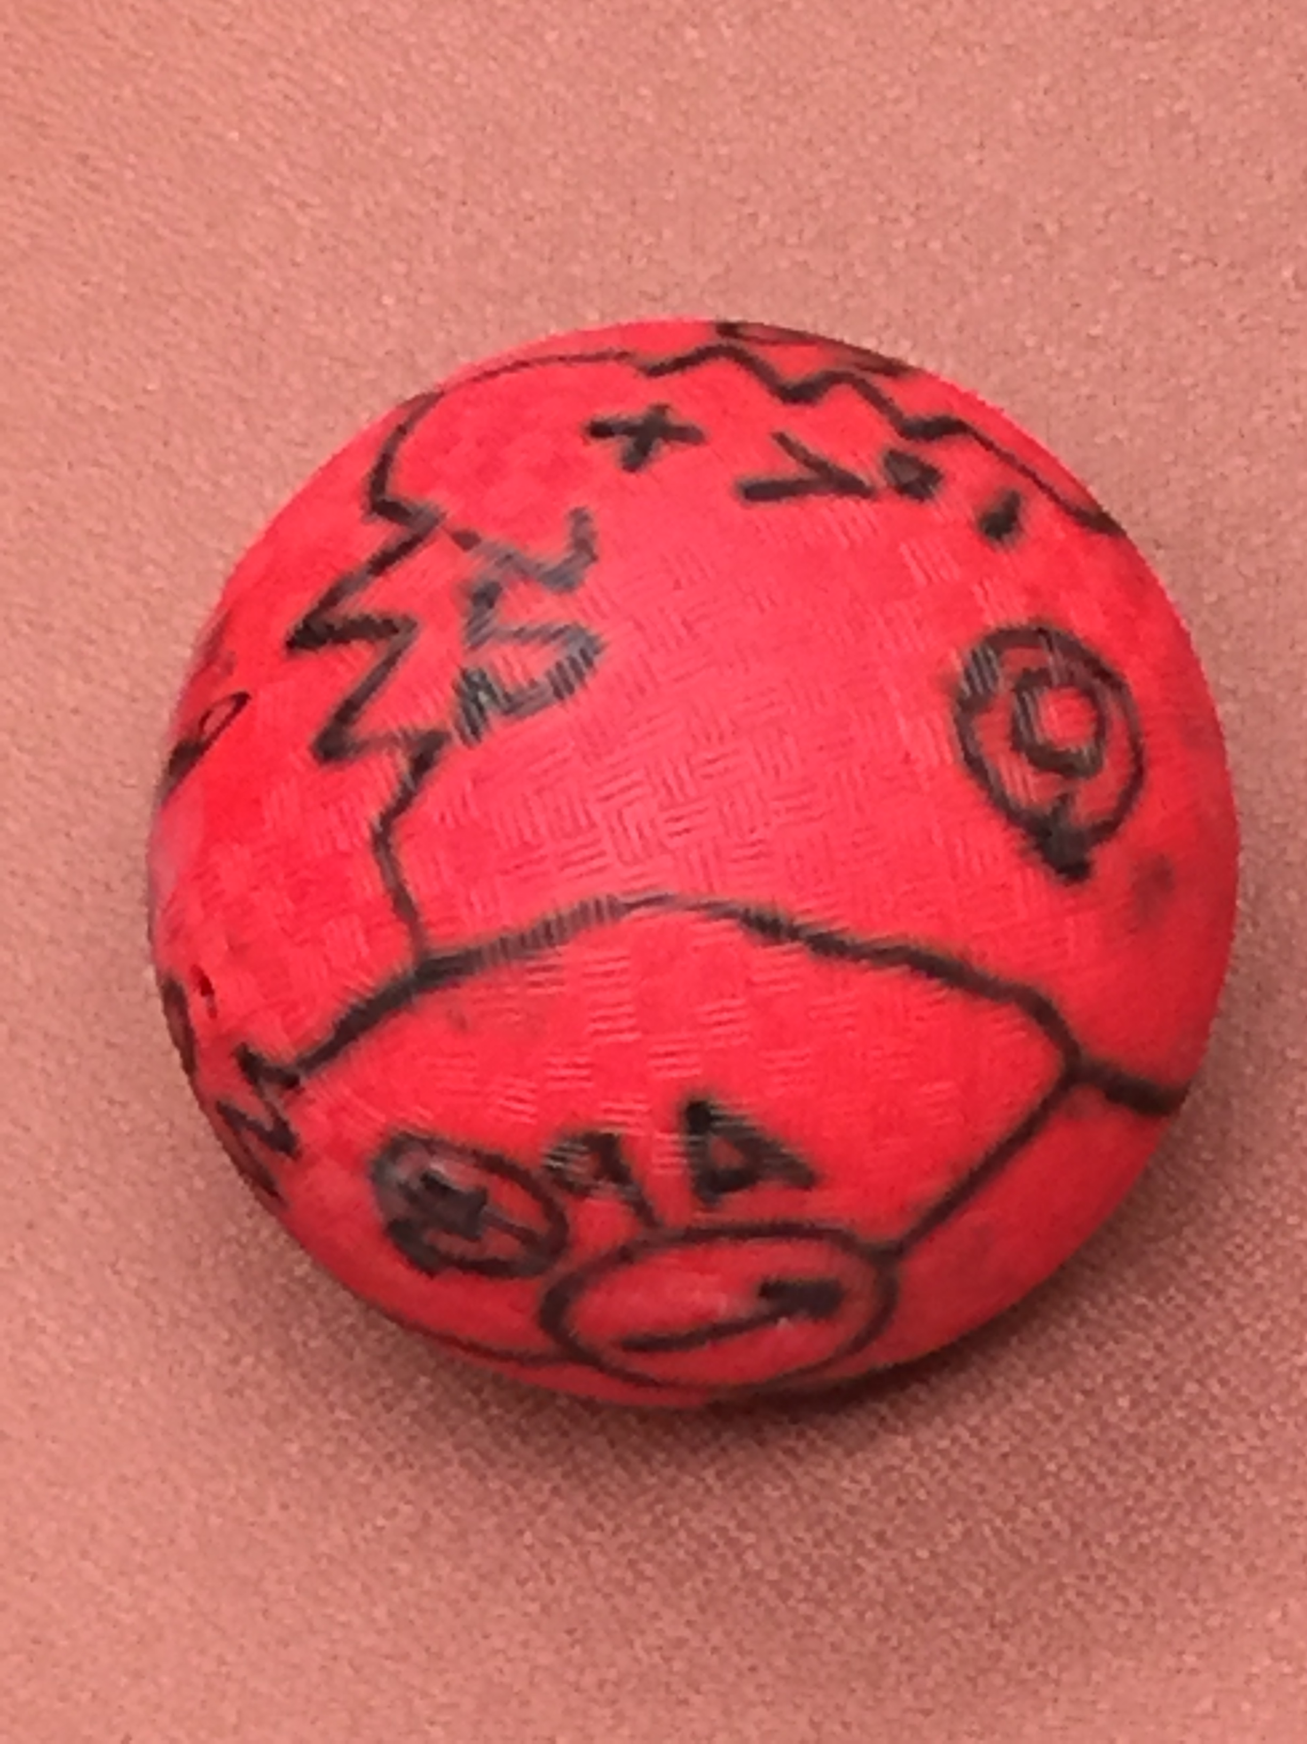
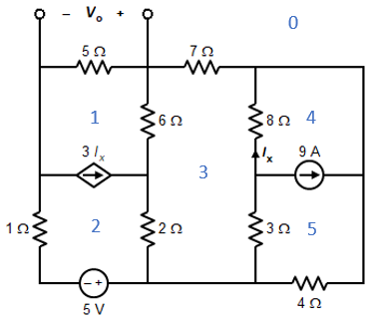
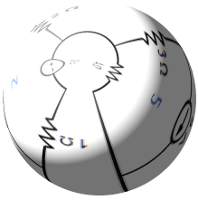
Circuit Wrapped Onto a Sphere
Can unwrap the drawing on the sphere to make ANY mesh the outer mesh, without changing the circuit at all

Slide 37
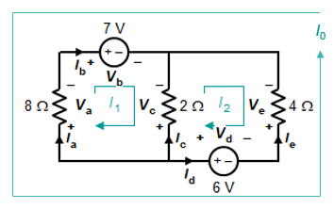
New View of Meshes & Mesh Currents
            A mesh is a loop that does not enclose any smaller loops, or that is not enclosed by or a portion of any larger loop in a planar circuit.
            Every mesh should therefore have a mesh current, including the outer mesh
            That of the outer mesh must go counter-clockwise for consistency if the inner mesh currents are clockwise (think of the sphere)
            Now every branch current is a difference of mesh currents, just as every branch voltage is a difference of node voltages;
            e.g., I_{b} = I₁ − I₀ above, etc.
            Now it is clear why all mesh currents are fictitious, exactly as node voltages are; adding any value to all mesh currents leaves all branch currents unchanged, exactly as adding any value to all node voltages leaves all branch voltages unchanged. Neither can ever be measured!
            Leads to a new version of mesh analysis in which one can choose any mesh as the reference mesh, making it properly dual to nodal analysis (as it should be!

Slide 38
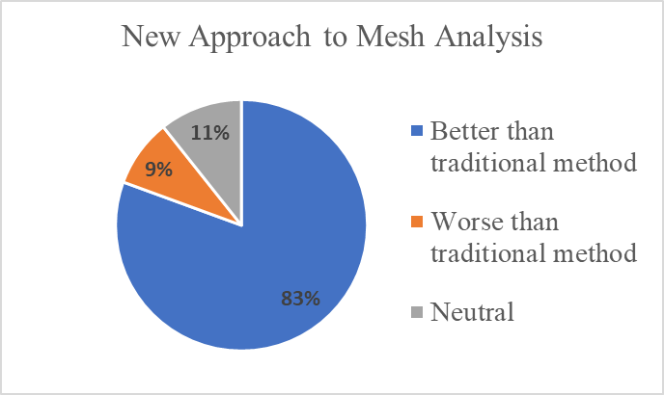
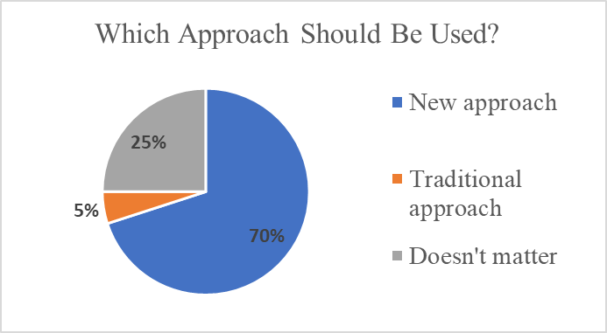
Survey Results on New Approach to Mesh Analysis (Fall ‘19, Fall ‘20, and Spring ’21)
195 students in 10 class sections at four institutions who used the revised version of the tutorial on mesh analysis (fully dual to nodal analysis)
Comparing to traditional approach in their textbooks

Slide 39
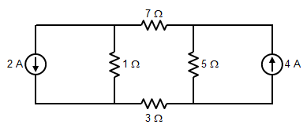
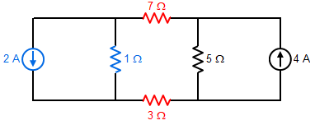
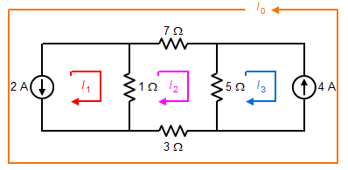
New Mesh Definition Leads to Improved Definition of Series Elements!
Conventionally, elements are in series if they carry the same physical current
Typical operational definition: Two elements are in series if they are connected to the same node, & no other elements are connected to that node
Which, if any circuit elements at right are
individually in series?
Typically, elements said to be in parallel if
they are connected to the same pair of
nodes, and therefore have the same
physical voltage (= difference of node voltages)
Dual version of parallel definition:
Elements are in series if they are connected in the same pair of meshes. (Branch currents are difference of same two mesh currents!)

Slide 40
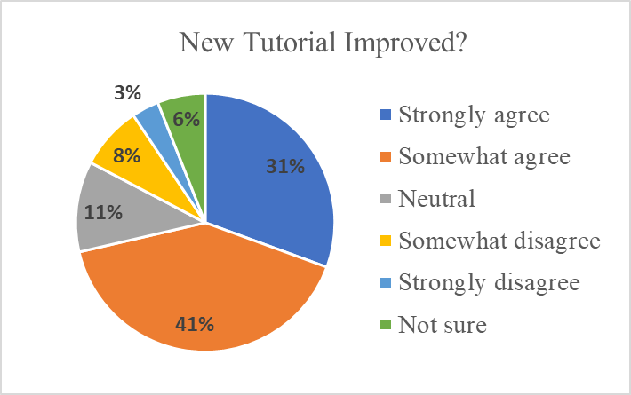
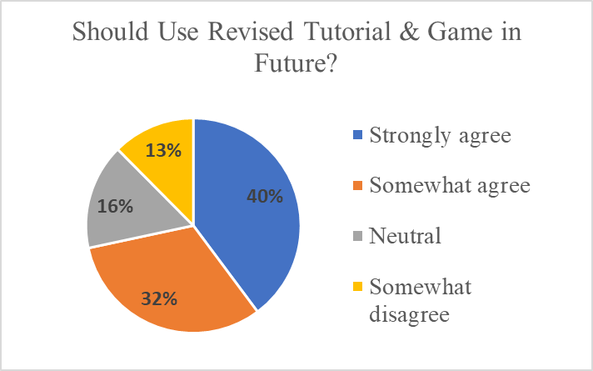
Survey Results on New Approach to Series Connections (Spring 2020)
88 students in 3 sections used both versions of the Series-Parallel game
72% strongly or somewhat agree that introductory tutorial (using both mesh-based and chain-based definitions of series connections) is improved and should be used in the future; only 11-13% disagree
Similar results obtained in Fall 2020 & subsequent semesters

Slide 41

New Approaches Lead to a Novel, Fully Dual Approach to Circuit Analysis
(Can reduce cognitive load on students when studying highly interconnected systems such as circuits)
Examples of dual terms:
Branch current | Branch voltage
Kirchhoff’s current law (KCL) | Kirchhoff’s voltage law (KVL)
Mesh (including outer mesh) | Node
Mesh current | Node voltage/potential
Loop | Cutset
Parallel | Series
Current source | Voltage source
Open circuit | Short circuit
Resistance | Conductance
Inductance | Capacitance

Slide 42
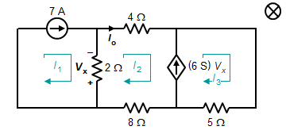
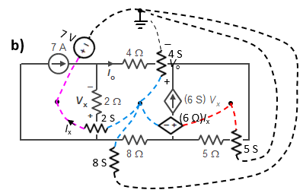
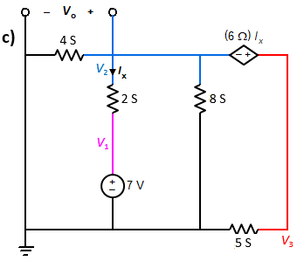
Geometric Duals of Circuits
Current constraints: I₃ – I₂ = (6 S) V_{x}, I₁ = 7 A Sought current: I_{o} = I₂
(I₂ – I₁)(2 Ω) + I₂(4 Ω) + I₃(5 Ω) + I₂(8 Ω) = 0
(KVL for supermesh of meshes 2 & 3), and
V_{x} = (I₂ – I₁)(2 Ω) (control voltage).
Voltage constraints: V₃ – V₂ = (6 Ω) I_{x}, V₁ = 7 V
Sought voltage: V_{o} = V₂
(V₂ – V₁)(2 S) + V₂(4 S) + V₃(5 S) + V₂(8 S) = 0
(KCL for supernode of nodes 2 & 3), and
I_{x} = (V₂ – V₁)(2 S) (control current).

Slide 43
Example of Duality as a Unifying Instructional Principle
Parallel Circuit
Series Circuit
I_{A} + I_{B} + I_{C} + I_{D} + I_{E} + I_{F} = 0 (KCL)
V_{A} + V_{B} + V_{C} + V_{D} + V_{E} + V_{F} = 0 (KVL)
‒
+
V_{A}
‒
V_{A}
I_{A}
A′
I_{B}
A
V_{B}
‒
‒
+
+
V_{F}
V_{B}
F
I_{A}
+
B
F′
B′
‒
V_{F}
I_{F}
+
‒
+
I_{B}
I_{E}
I_{F}
I_{C}
I_{C}
+
V_{C}
‒
+
E
I_{D}
C
‒
E′
C′
+
V_{E}
V_{C}
‒
V_{E}
+
+
‒
D
V_{D}
I_{E}
D′
I_{D}
‒
‒
V_{D}
+
V_{A} = V_{B} = V_{C} = V_{D} = V_{E} = V_{F}
I_{A} = I_{B} = I_{C} = I_{D} = I_{E} = I_{F}

Slide 44
Summary
www.circuittutor.com
            Circuit Tutor is an example of a (non-ITS) step-based tutoring system designed to minimize frustration and maximize learning through immediate feedback
            It accepts every step of a student’s work using special interfaces and ensures actual use of intended solution methods; downside is learning curve due to those interfaces
            It generates random problems for every student, providing an unlimited supply and preventing use of solution manuals or copying
            Has multiple carefully graded levels of difficulty, with isomorphic fully worked examples
            No penalty for errors (other than having to work additional problems) to promote success;
            uses mastery learning approach
            Pedagogical innovations include color-coded nodes and meshes, and conceptual emphasis
            Student support features include 83 YouTube videos covering all problem types, introductory multiple-choice tutorials (new or custom ones can be created directly from a specially-formatted Word document), and auto-generated transcripts of student work to use in reviewing
            Topical coverage includes 23 games covering most major course topics; additional ones in development
skromme@asu.edu

Slide 45
Summary (cont.)
            Seven controlled evaluations (6/7 randomized) of 10 different modules showed statistically significant effect sizes of 1.21, 0.41, 0.97, 0.72, 0.54, and 0.64 std. deviations (Cohen d-values) and five (non-cross-contaminated) cases with no significant difference, compared to paper HW or the commercial WileyPLUS system
            Student survey results showed very strong preferences for Circuit Tutor over paper HW or commercial answer-based systems (WileyPLUS, Pearson Mastering), e.g., 86%-9%, 84%-11%,
            68%-23%, 69%-12%, or d = 0.91, d = 2.07, d = 1.01)
            Comprehensive independent evaluation showed high opinions of both students and instructors (86% of latter would recommend adoption) and ranked popularity of features
            Used by over 9000 students (active users) in 249 distinct class sections taught by 67 distinct instructors at 16 different colleges & universities of diverse types (five minority-serving)
            Used extensively to support both online (asynchronous) courses and remote instruction during the pandemic; students found it to have a positive impact during the pandemic
            Features extensive administrative support features including instructor dashboard & gradebook

Slide 46
Summary (cont.)
            Successful in-class approaches developed to improve conceptual learning about electricity
            Project unexpectedly led to discovery of several new linear circuit analysis principles (voltage- and current-splittability; new definition of a mesh; new dualized approach to mesh analysis; improved definition of series elements); mostly incorporated into Circuit Tutor & well received by students
            Above results led to a new appreciation of the importance of duality in linear circuit analysis, which the P.I. proposes could be used to re-organize our whole approach to the subject (as currently
            already done in digital circuit courses based on Boolean algebra)
            Some future research questions:
              How can duality best be exploited in teaching linear circuit analysis?
              What is the importance of spatial reasoning about circuits in learning this subject?
              How can this skill be better taught?
              Can use of desirable learning difficulties improve learning of this or related subjects?
              Can step-based learning be similarly effective in other subject areas (statics, dynamics, etc.)?
              Could introduction of a full ITS architecture further improve learning in Circuit Tutor?

Slide 47
Discussion Activities
            Is there a course you teach where a step-based tutoring system could be useful? What is that course?
            How might you design such a system, and why?
            What would be the best way to use a system like that to promote learning?
            Would it make sense to include random problem generation in your domain? What would that look like?
            Is there an alternative approach that might work better in your course? If so, what would that look like?
            What other take-aways from this workshop are potentially valuable to you?

Slide 48
Independent Evaluation of Circuit Tutor (CREST Center at ASU)
Evaluation of the system was carried out by an independent evaluation team (Drs. Wendy Barnard and Megan O’Donnell) in the College Research and Evaluation Services Team (CREST) at ASU
It focused on implementation, usability, and satisfaction across the four participating campuses in our IUSE grant: ASU, University of Texas at El Paso (UTEP), Florida A&M/Florida State University (FAMU/FSU), and Morgan State University (MSU)
A mixed methods approach was utilized through the combination of student and instructor surveys and document review
The survey captured both quantitative and qualitative data using Likert scale items and open-ended questions
The evaluation focused on five major questions:
1. To what extent was Circuit Tutor implemented effectively across the four partnering universities?
2. How did students perceive the utility of Circuit Tutor in supporting their course learning?
3. How did instructors perceive Circuit Tutor to impact their teaching experiences?
4. How did instructors perceive their students to experience Circuit Tutor in their course learning?
5. To what extent were students satisfied with Circuit Tutor?

Slide 49
Independent Evaluation of Circuit Tutor (CREST Center at ASU) (cont.)
The most recent evaluation focused on the Fall 2020 and Spring 2021
Courses taught cross both semesters: 30 Circuits I sections (1,434 students), and one Circuits II course,
(40 students).
A total of 17 distinct instructors taught a total of 33 class sections during this time at the four institutions.
A total of 21 different games (tutorials) were used.
Of the total students listed within the Circuit Tutor database, 1223 were at ASU, 59 at FAMU/FSU, 91 at MSU, and 101 at UTEP.
Surveys sent to 623 students; 58% response rate
Overall, students had very favorable experiences using Circuit Tutor across these two semesters. At least 48% in the Fall 2020 semester and 60% in the Spring 2021 semester agreed or strongly agreed with all these survey items on favorable aspects of Circuit Tutor
Students who had used both Circuit Tutor and Pearson’s MasteringEngineering for the Nilsson-Riedel textbook (N = 94) preferred Circuit Tutor in surveys by a margin of 69% vs. 12% for the latter (the rest were neutral), similar to ASU students who compared Circuit Tutor to WileyPLUS for the Irwin textbook

Slide 50
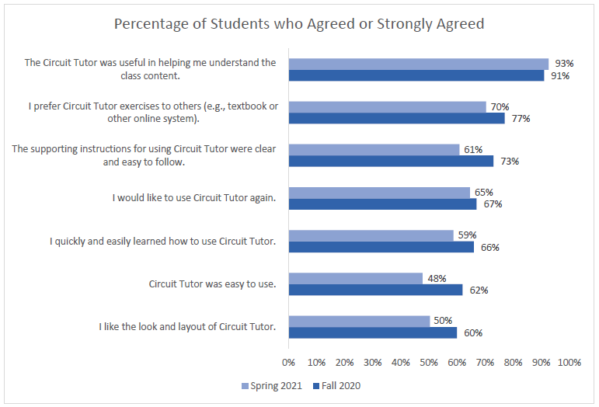
Independent Evaluation of Circuit Tutor (CREST Center at ASU) (cont.)

Slide 51
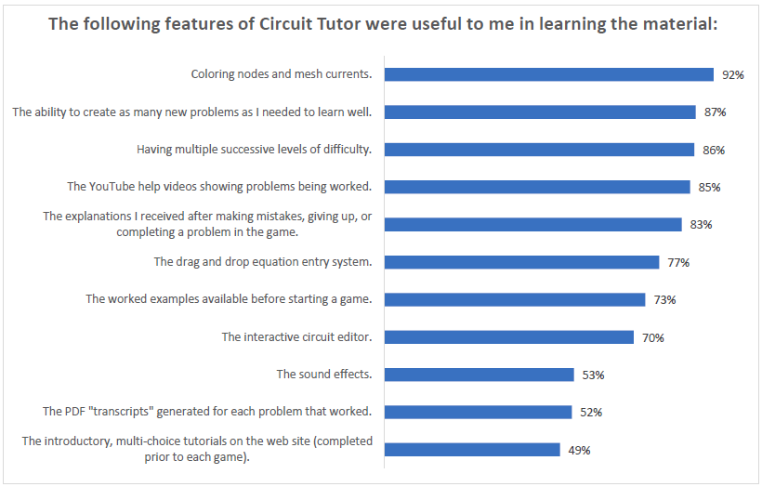
Independent Evaluation of Circuit Tutor (CREST Center at ASU) (cont.)

Slide 52

Independent Evaluation of Circuit Tutor (CREST Center at ASU) (cont.)
Instructors were surveyed in Spring 2021
Generally, they had favorable teaching experiences using Circuit Tutor
Overall, 57% (4 out of 7) of instructors reported that Circuit Tutor made teaching their classes more effective than the previously used homework system used to teach students
57% (4/7) reported that Circuit Tutor made it somewhat or much easier to teach their classes compared to other types of homework systems for that class
Slightly less than half of the instructors (43%; 3/7) reported that their students were somewhat more motivated or much more motivated to study linear circuit analysis when using Circuit Tutor compared to the other homework system

Slide 53
Independent Evaluation of Circuit Tutor (CREST Center at ASU) (cont.)
Instructors were also surveyed on the most useful features of Circuit Tutor:

